Slide 1
ECE 3740 Systems Engineering Principles Mid Term Test
Nov 6, 5-9:00 PM
/50

Slide 2
Midterm Test Date & Deadlines
Start Time:
Nov 6, 2020 @ 5:00 pm.
Submission End Time:
Nov 6, 2020 @ 9:00 pm.
The submission folder will be closed at 9:30 pm.

Slide 3
The Rules
This is an open book test: students may use their personal laptop computers; lab computers; personal notes; lecture slides; calculators; and personal C and Java files.
Students may use an Internet search engine, such as Google, only for obtaining information about C and Java coding.
Students are prohibited from using the Internet for any other purpose.
Students are prohibited from consulting (speaking, chatting, etc.) with anyone regarding any aspect of this test throughout the entire duration of this test.
A student may not do the test in the same building or same room as another student doing the same test.

Slide 4
Signature Page
Name | Student Number | Signature
Mohammad Elsayyed | 7876820 | Mohammad Elsayyed
Enter your name, student number, and signature (type name again; your typing will appear in a signature font).
By entering your details above, you honestly declare that you have not consulted (spoken, chatted, etc.) with anyone regarding any aspect of this test throughout the entire duration of this test.

Slide 5
Authentication Information
Please submit the following information (the information is needed for authentication and to verify integrity, only: it will not be used for any other purpose).
Paste a screen capture of the output of the OS program named “ipconfig”.
Here are instructions:
Open a “command prompt” window. Click on the “Type here to search” button on the lower left hand side of your Windows screen, and type “Command Prompt” (without the quotes).
In the “Command Prompt” that appears, type the following in order (without quotes):
Type “time”
Type Control-C (Type Ctrl and c at the same time)
Type “ipconfig”
Type “time”
Type Control-C (Type Ctrl and c at the same time)
Type Alt-PrtScn (Type Alt and PrtScn at the same time). This will capture the screen as a bitmap.
Paste the bitmap into the following slide (Slide 6). Note I have pasted an example output on Slide 7.

Slide 6
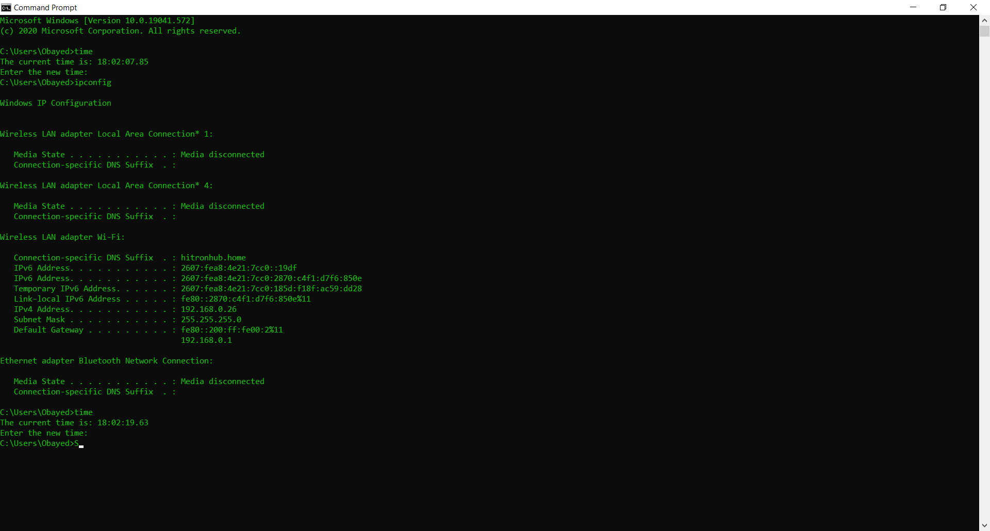

Slide 7
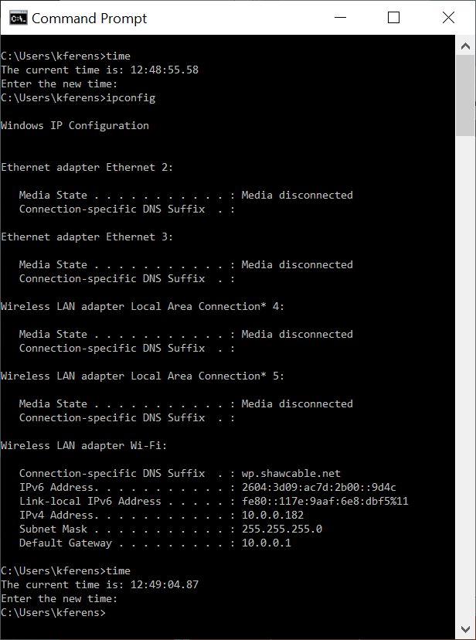
Example Output

Slide 8
Question 1 (Q1)
Refactor the given Server software, Q1Server.zip, so that its “send data to a client” method is overloaded.
Currently, the ClientConnection class has two differently named methods for sending data to a client.
sendMessageToClient(byte msg)
sendStringMessageToClient(String theMessage)
It would be better object oriented design if there was a single overloaded method for sending data to a client, as follows:
sendMessageToClient(byte msg)
sendMessageToClient(String msg)
sendMessageToClient(int msg)
After refactoring, ensure that ClientConnection has exactly three versions (overloaded methods) of sending data to a client, as listed above. This means it should have the three methods listed above, and no less than the three methods listed above, and no more than the three methods listed above for sending data to a client.

Slide 9

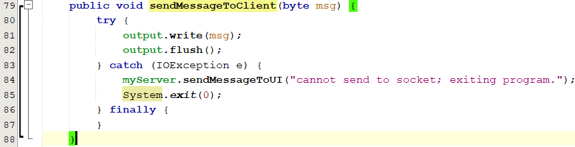
(5 Marks) Q1 Part 1: Explanation of sendMessageToClient(byte msg)
This method is used if it was passed a byte value message, and the other two is disregarded. (Dynamically)
This’s one of the methods, it takes a “byte” as input, and write it on the output socket, then flush it to be sent, if any problem happened with outputting, it would go to the exception, and display a message by sending a message on the UI.
In: ClientConnection.java, clientconnection package, from line 79-88 (at this step, maybe it’ll change later)

Slide 10
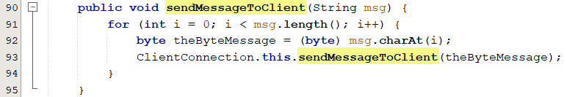
(10 Marks) Q1 Part 2: Explanation of sendMessageToClient(String msg)
This method is used if it was passed a string value, and the other two is disregarded. (Dynamically)
This’s one of the overloaded methods, it takes a “String” as a input, then loop on each char of the string and converting msg.charAt(i) each one into a byte, and down casting that char into a byte (byte), and storing it in a byte variable, then sending that byte contents to the other/previous overloaded method that takes Byte as input to be written then flushed.
In: ClientConnection.java, clientconnection package, from line 90-95 (at this step, maybe it’ll change later)

Slide 11
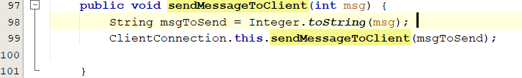
(10 Marks) Q1 Part 3: Explanation of sendMessageToClient(int msg)
This method is used if it was passed a int value, and the other two is disregarded. (Dynamically)
This’s one of the overloaded methods, it takes int as a input, then using the Integer.toString(msg) method we convert the input into a String variable to be passed again to the previous overloaded methods, till it reaches the first one to be written and flushed.
In: ClientConnection.java, clientconnection package, from line 97-101 (at this step, maybe it’ll change later)

Slide 12
(10 Marks) Q1 Part 4: Explanation of “Exactly Three Methods”
Explain what you did to “ensure that ClientConnection has exactly three versions(overloaded methods) of sending data to a client, as listed above”; no less and no more.
Answer:
The only class that uses our overloaded methods, is ClientMessageHandler, by inspecting other codes navigator bar, which shows all the variables used and the functions as well, and also Ctrl-F would search for all incidents of what you search for.

Slide 13
(10 Marks) Q1 Part 5: Explanation of “Other Changes”
Explain what changes you made in other parts of the Server project, other than the changes you made in ClientConnection.
Answer: I didn’t really change other part of the server project, because whatever was using the previous overloaded message for the string would change automatically in all the project files, if it was normal change, I would go for ClientMessageHandler class, and whenever sendStringMessageToClient showed I would manually replace it by sendMessageToClient, also I didn’t have to care which one is used where, because all of the methods are overloaded so java would dynamically choose which message corresponds to the given input.

Slide 14
(5 Marks) Q1 Part 6:
Identify which overloaded function is currently being unused?
Answer: sendMessageToClient(int msg), since all messages being sent in the ClientMessageHandler class are either bytes (0xFF) or string messages.
Explain what possible reason this unused method can be used for? (More examples in the voice recording)
Answer: if a number like the port number was requested by the client or as a termination message after each command which’s really not recommended.
Also, if the server is some sort of address book it would use numbers solely for telling the client the requested phone number.

Slide 15
Typed Answer Template
Explain your answer here.
Using a different slide for each part of the question. You may use additional slides for a part, as needed.
For each explanation slide you have, embed your accompanying verbal explanation into the slide, using PowerPoint’s “insert->audio-Record Audio…” feature.
Do NOT show the NetBeans IDE.

Slide 16
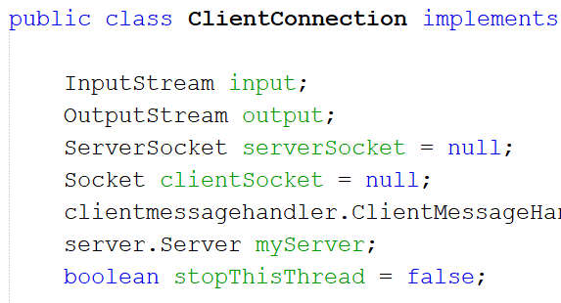
Code Answer Template:
This is my explanation of the code.

Slide 17
Test Submission Format See Recording for Additional Information
Identification video recording (in .mp4 format) showing:
Show your face and student card for approximately 5 s. State your name and student number in the video.
PowerPoint file: Lastname.Firstname.Midterm Test v2.pptx
Submit your typed answers with embedded verbal explanations.
Your verbal explanations should be embedded into the slides using PowerPoint’s “insert->audio->Record Audio” feature, as explained and demonstrated in this morning’s class.
Do NOT show your solutions in NetBeans IDE. You will need to copy your solution code from NetBeans and paste them into these PowerPoint slides (use “Alt->PrtScn”, paste into Paint, select the code of interest, copy it from Paint, and finally paste it into the PowerPoint slide).
Netbeans projects folder:
Submit your NetBeans project solution in a separate folder.
Zip your identification video recording, PowerPoint file, and NetBeans project folder into one package, naming it: Lastname.Firstname.zip, as shown in the following slide:

Slide 18
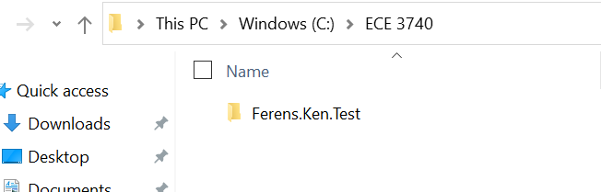
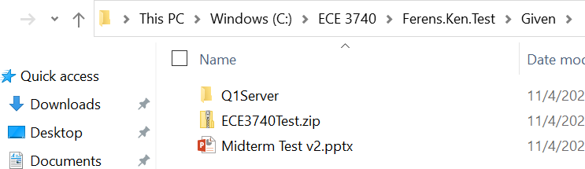
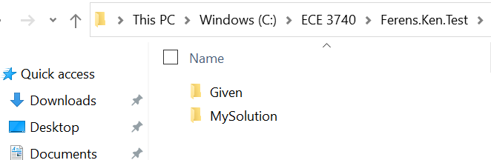
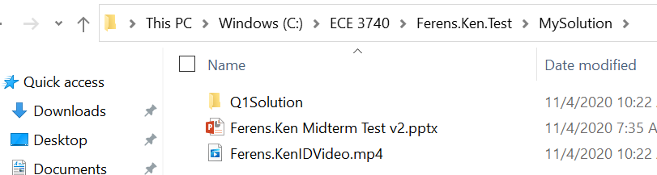
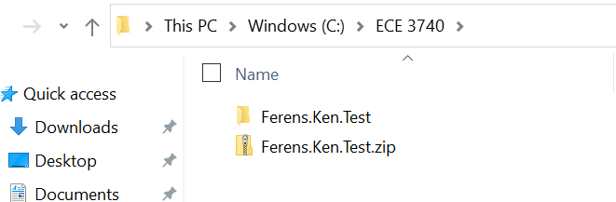
Zip Package Format
1
3
2
4
5

Slide 19
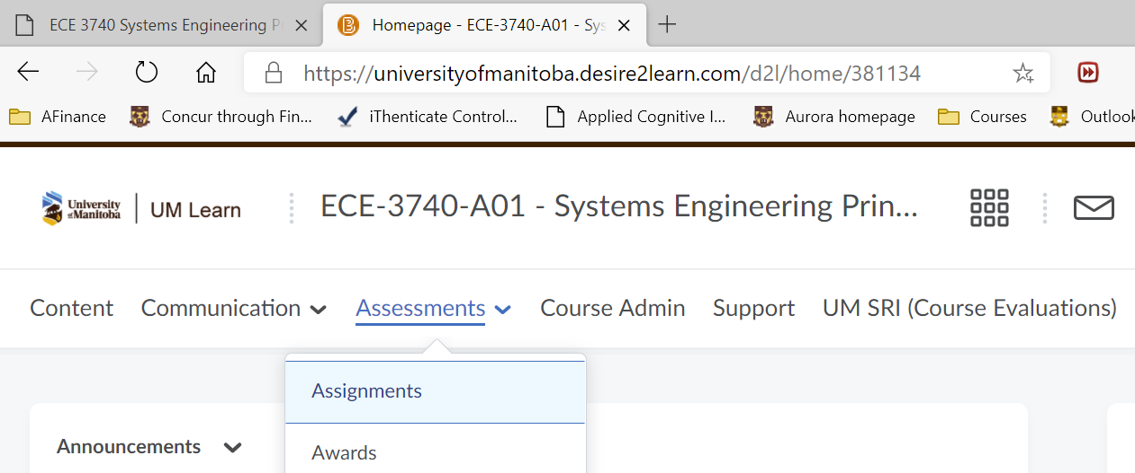
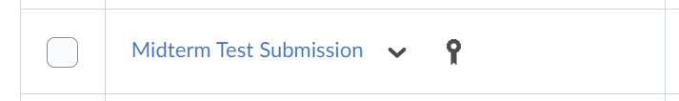
Test Submission Location See Recording for Additional Information
Submit your zipped package (Lastname.Firstname.zip) to umlearn:
Assessment->Assignments->Midterm Test Submission:

